Slide 1
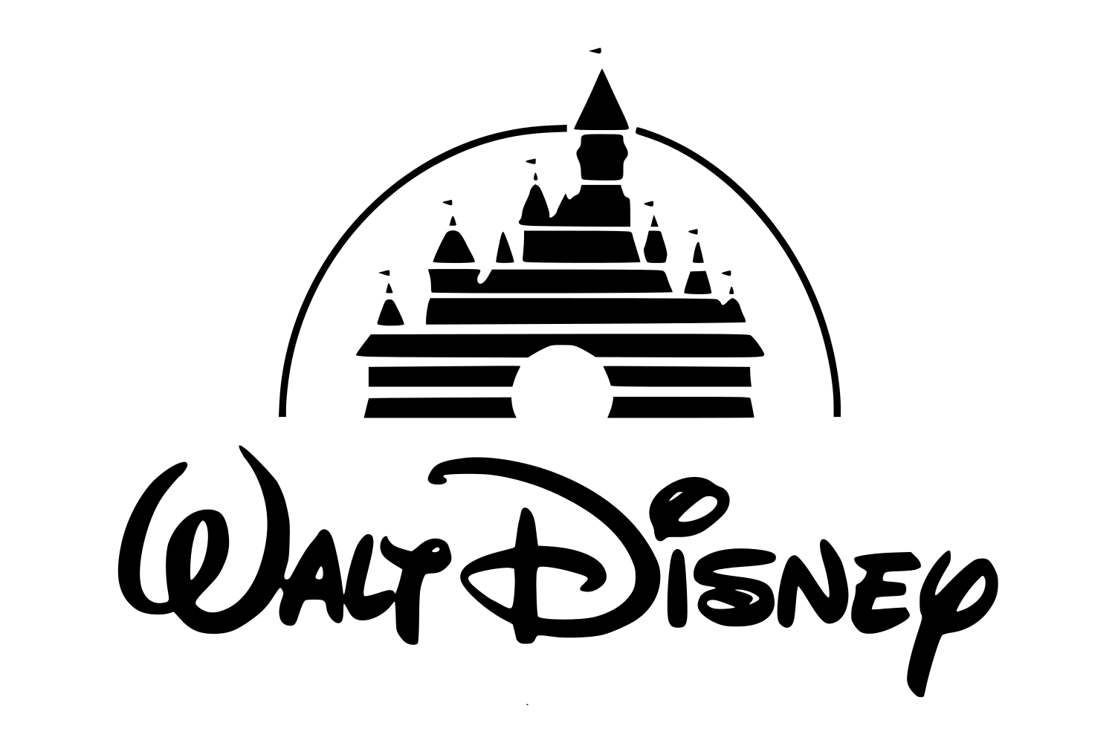
Walt Disney Company (NYSE:DIS)
August 21st, 2019

Slide 2
Recommendation: Buy
INVESTMENT THESES
RECOMMENDATION SUMMARY
Price on Valuation Date | $135.75
12 Month Target Price | $154
Dividend Yield | 1.3%
Implied Total Return | 14.77%
I) Cohesive Business Model
II) Protected and Valuable Intellectual Property
PRICE VS VOLUME L12M
ANALYST CONSENSUS
Based on 13 analyst reports, 10 have a Buy rating, 3 have a Hold, and none have Underperform or Sell

Slide 3
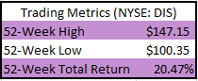
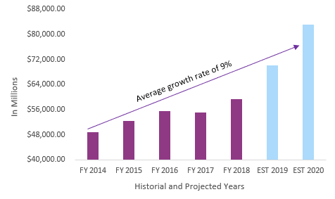



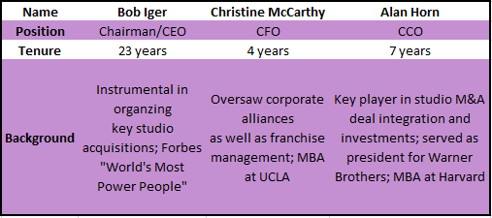
Company Overview
BUSINESS DESCRIPTION
DISNEY TOTAL REVENUE ($USD IN MILLIONS)
Disney is a diversified mass media and entertainment conglomerate founded in 1923 with revenue segments in Media Networks, Parks and Resorts, Studio Entertainment, and Consumer Products and Interactive Media
Although considered a mature company, revenue is growing 9% on average which showcases that this is a long-term hold
Revenue for 2018 and 2019 has 18% growth however
2018 REVENUE DISTRIBUTION BY SEGMENT
MANAGEMENT TEAM
Experienced management team leading a media monopoly with high growth potential in revenue

Slide 4
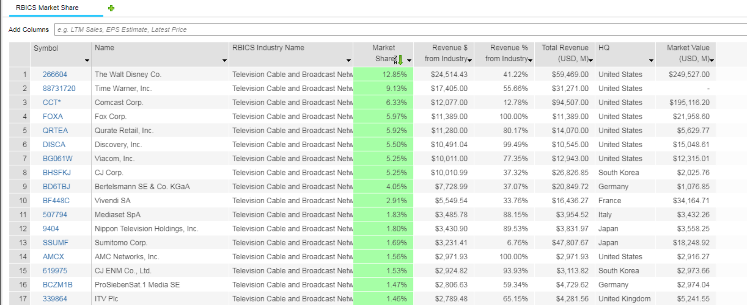
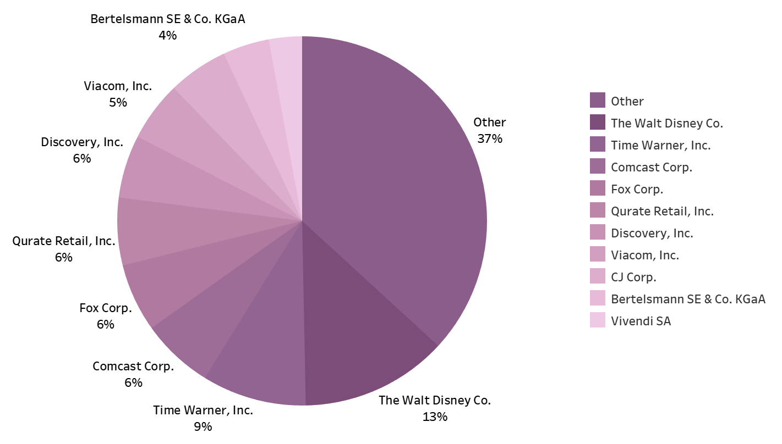
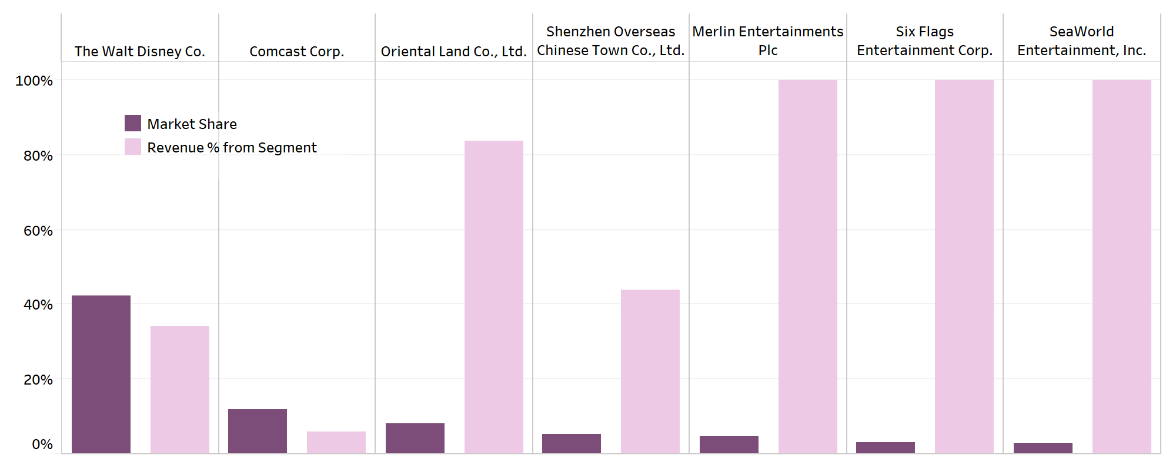
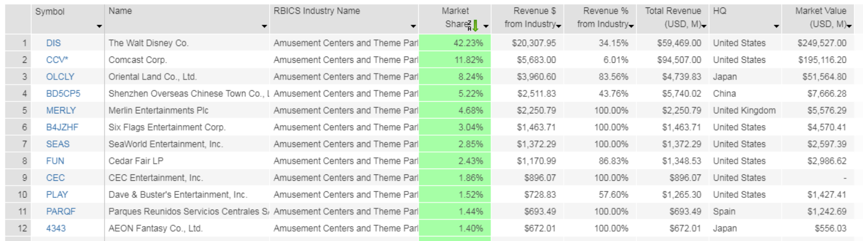
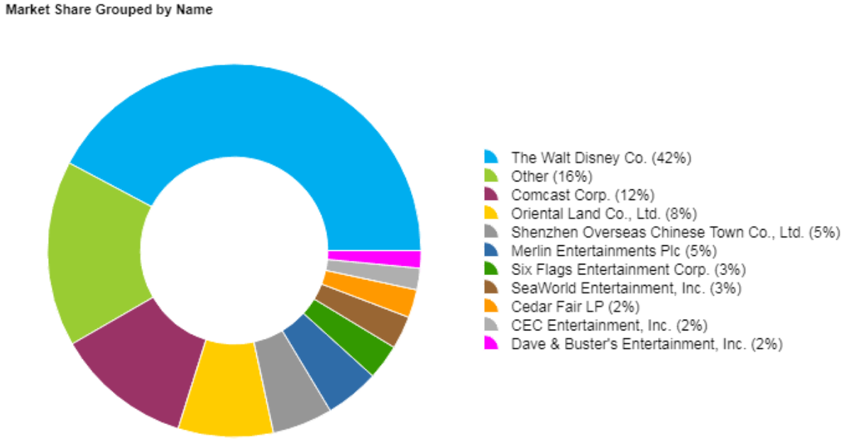




Industry Outlooks
Media Networks
Parks and Resorts
Highly fragmented market with a recent trend of consolidation.
Walt Disney Company is the market leader with 13% share which represents 41% of its revenue, 25 of which come from ESPN.
Upcoming merger between Comcast and Viacom will create an extremely competitive market force with share of 12% and extensive resources.
Consumers moving away from traditional TV to alternative media outlets.
48% of all US consumers streamed TV content every day or weekly in 2017.
Global 5% surge in theme park spending in 2018 which, with the help of the “Experience Economy”, drives market revenue to $45 billion.
Domestic tourist makes up 73% of the total tourism globally.
China has quickly grown to be the leader in domestic tourism.
Increased competition due to theme park openings such as Universal's Harry Potter-themed land in Orlando and Hollywood.
Highly industry specific competitors.
Studio Entertainment and Direct-to-Consumer
Netflix is expected to spend $15 billion on content production in 2019 alone, up from $12 billion on 2018.
Amazon will spend between $5 and $6 billion dollars on content in 2018 while also doubling Netflix in terms of advertising spend.
Disney’s coming release of Disney+ bundled with Hulu and ESPN+ to compete with Netflix, Apple TV+, AT&T TV, HBO Max and NBCUniversal.
Disney executives forecast that the upcoming streaming services will not achieve profitability until 2024.
US consumers now pay over $2 billion monthly for subscription-video services.
55 percent of US households now subscribe to paid streaming video services,

Slide 5
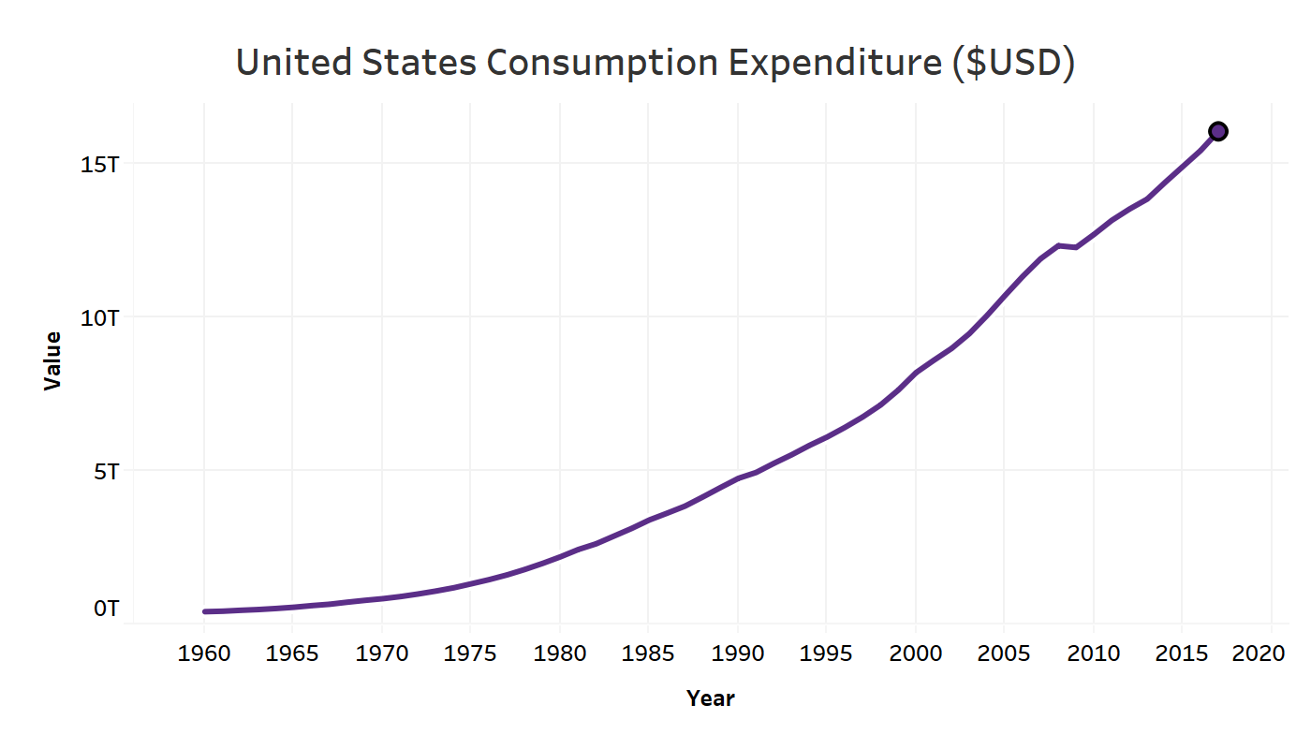
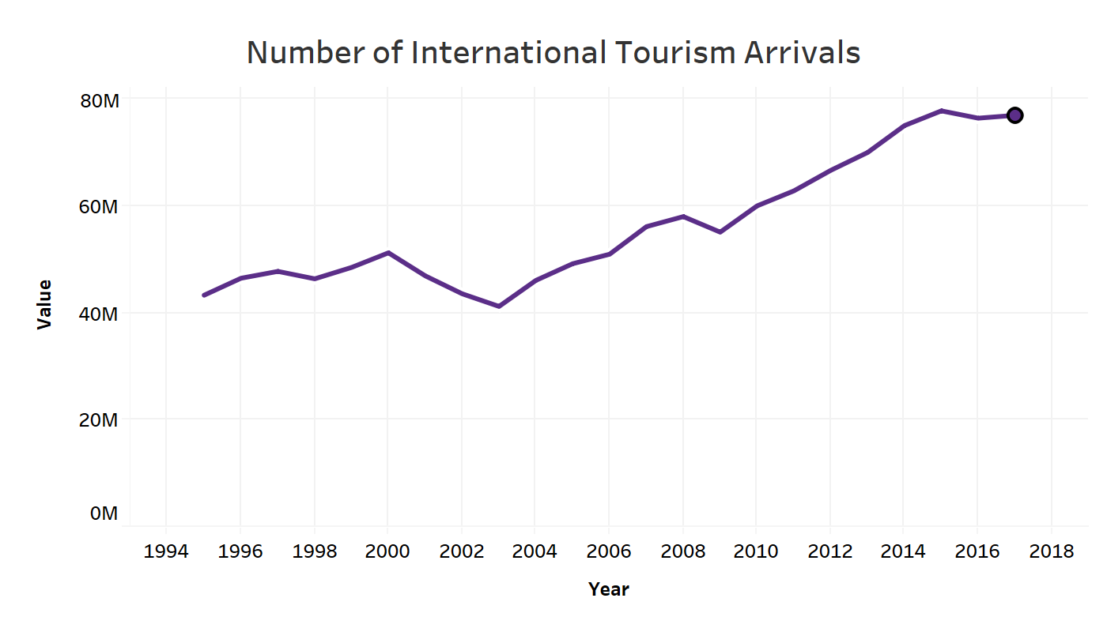
Macroeconomic Outlook
MACROECONOMICS
Consumer Spending and Economic Business Cycle
Climbing U.S. consumer spending has been referred to as the backbone of the domestic economy in recent years.
U.S. GDP growth is expected to remain between 2-3% which will continue to drive consumer spending
National unemployment rate determines the health of the economy and it is below 4%, its lowest point since 1969.
Economic growth means companies are expanding and with extremely low unemployment there is an upward pressure on wages.
This wage growth and low unemployment opens opportunities for increases in discretionary spending.
International relations.
Consumer spending as tied to the economic business cycle.
China trade war?
Decline in pay T.V. households in the United States (could be micro)
literally anything to do with GDP, consumer spending, or rise in discretionary income
maybe mention how we are defensive during a recessionary period surprisingly; 2008-2009 recession
International Tourism and Relations
UNWTO estimates that worldwide international tourist arrivals (overnight visitors) increased 6% to 1.4 billion in 2018, clearly above the 3.7% growth registered in the global economy.
Arrivals to the Americas were below the world average (+3%) as compared to Asia and the Pacific and Europe (both at +6%).
More affordable travel and societal changes, mostly supportive of globalization, are a driving forces in the international tourism industry.
A large consortium of countries have recently issued travel warnings regarding mass shootings in the United States. This is not expected to have a meaningful impact on international tourism.

Slide 6
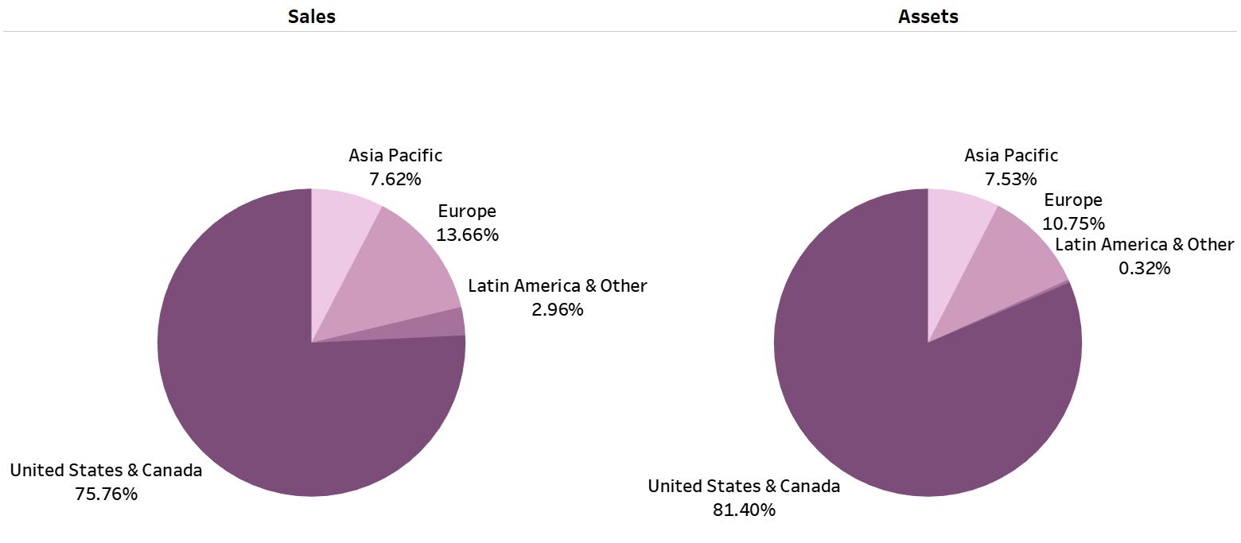

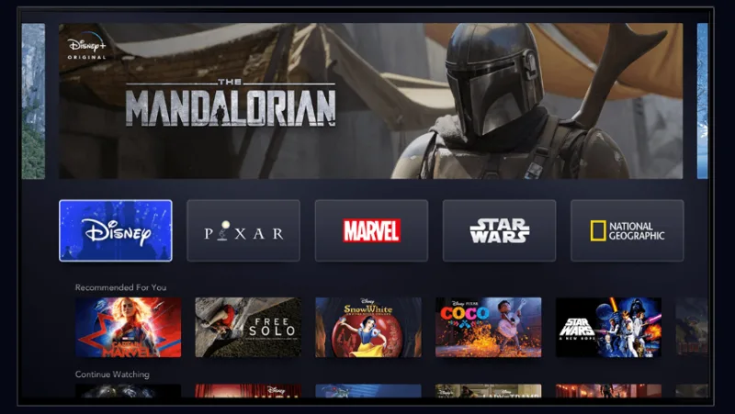


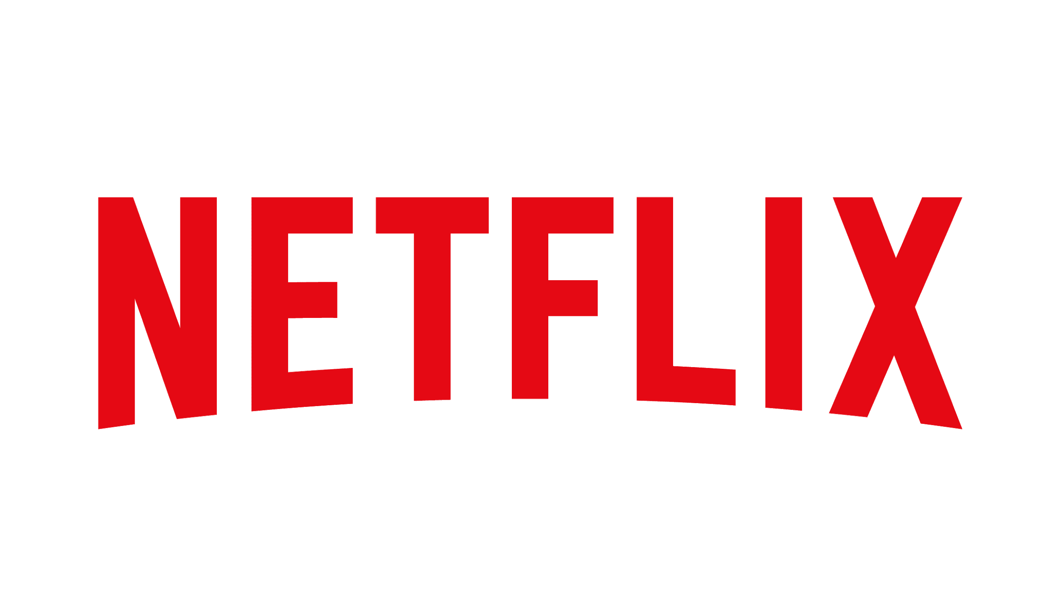



Key Catalysts: Streaming and International Expansion
STREAMING
Disney+ itself will have starting price of $6.99 and include the opportunity to be bundled with ESPN+ and Hulu at a competitive price of $12.99
It will focus more on quality content (higher rated titles) in regards to SVOD
Streaming industry will get extremely competitive as companies of all background start launching their own service
However, with Disney’s mixture of aggressive pricing, brand loyalty, and valuable content; we believe that Disney will come out on top
Recent acquisition of Hulu already gives Disney+ an extra 28 million subscribers
Device support includes web browsers and apps but more interestingly, Iger has stated that it would include Roku and Apple TV as well as video game consoles and mobile platforms
INTERNATIONAL EXPANSION – CHINA (PARKS & RESORTS)
China offers an amazing opportunity for entertainment parks
Disney just opened up Shanghai Disney after a decade of meticulous planning in regards to logistic and target demographic
Country’s middle class is forecast to double to 100 million by 2020 and the tourism industry $610 billion and that is predicted to double as well
INTERNATIONAL EXPANSION – INDIA (STREAMING)
India’s GDP growth has average 8% over the last decade with a market of around 600 million consumers below the age of 25
In the next 5 years, India will have over a billion screens
Disney's key acquisition of Star India and its subsidiary, Hotstar, provide the platform necessary to support a fully functional streaming service
Hotstar had more than 300 million active users in March – almost as many people living in the United States – which showcases the tremendous potential for expansion
Disney+ interface highlighting hero carousel
Streaming competitors
International expansion provides opportunity for growth and to interconnect segments

Slide 7
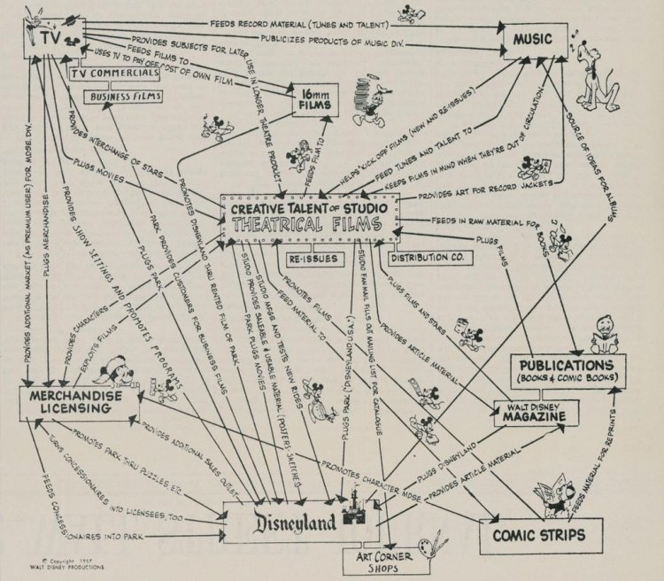
Investment Thesis I: Cohesive Business Model
One of a kind fully integrated and proven content supply chain which allows from multiplicative synergies over an extended time horizon throughout all business segments

Slide 8
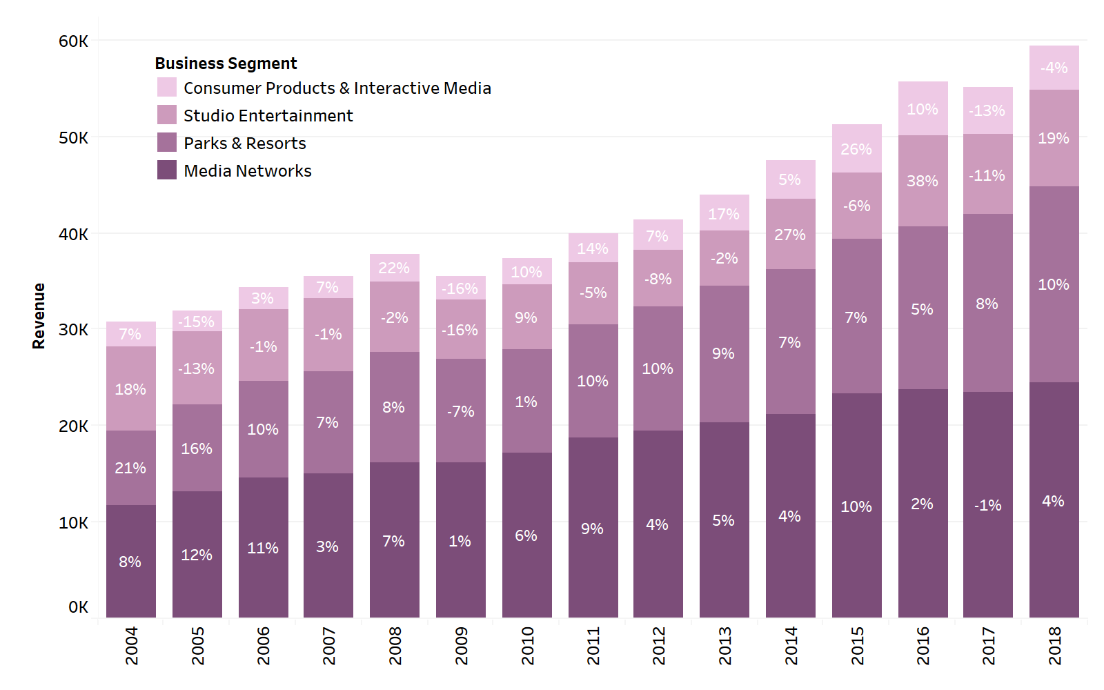
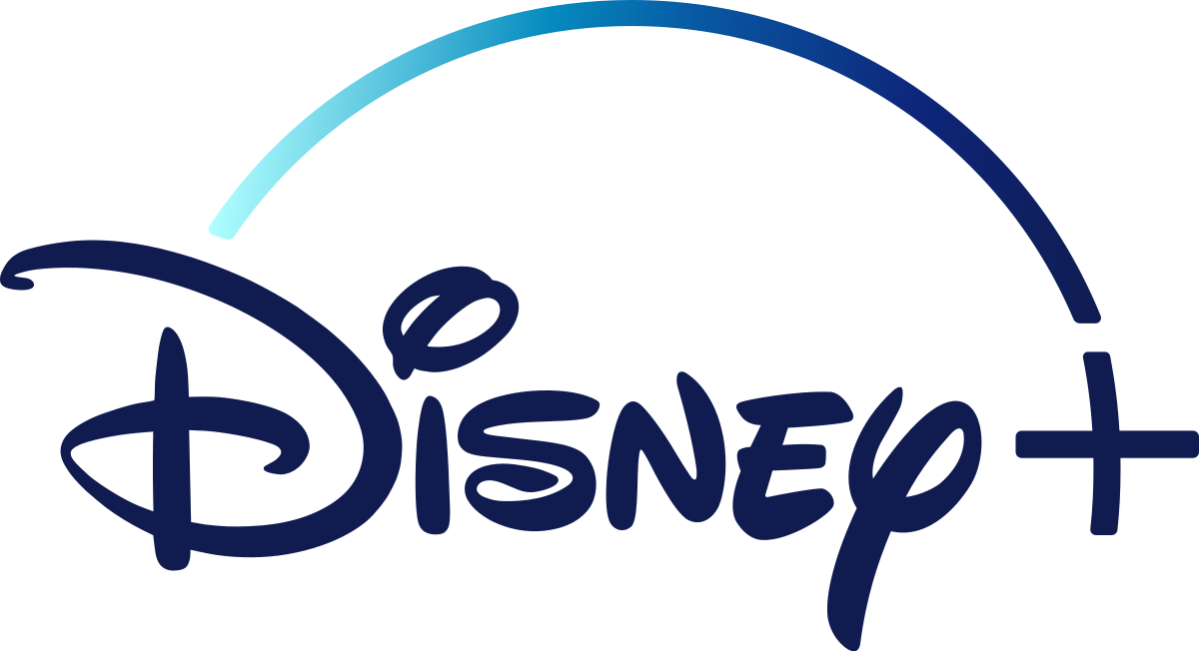









Investment Thesis I: Cohesive Business Model cont.
Ability to derive an unparalleled amount of value from its content
Vary few businesses how the ability to earn profit in one segment, while marketing for another through the creation of a incomparable customer relationship with the product itself.
Revenue from studio entertainment, media network content, and now the strategically implemented streaming service serve as lagging indicators and driver of future revenue.
This highly lucrative and growing future revenue comes from the Disney parks and resorts segment.
Both past and especially present content success
Avengers Endgame has grossed $860 million domestically and $2.8 billion worldwide.
Estimated $10.2 billion in 2018 revenue coming from ESPN alone, 6% up from the previous year.
With the Fox acquisition Disney has a controlling stake in Hulu which boasts 60 million subscribers as compared to only 30 million in 2018.
Hulu 100% growth represents a shift of control in the streaming universe as Netflix's domestic user base shrinks.
Positioned for the shift from traditional content consumption
71 billion dollar acquisition of 21st Century Fox which included National Geographic and Fox movie studios.
Bundling of ESPN+, Hulu and Disney Plus for the incredibly competitive price of 12.99, the same price as Netflix's most popular package, is expected to attract mass customer base who can be monetized through historically proven content marketing practices
Unique business model of content marketing is key to durable competitive advantage

Slide 9
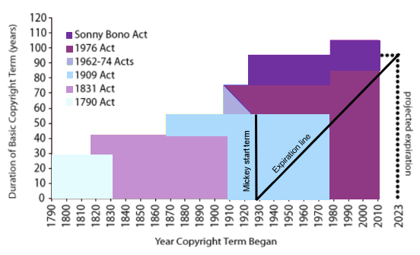



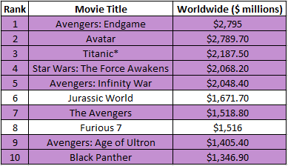
Investment Thesis II: Protected and Valuable Intellectual Property
BRAND EQUITY
COPYRIGHT DURATION VS. MICKEY MOUSE RENEWAL
Brand value estimated to be worth $45.8 billion, remaining the most valuable brand in the world for 2 consecutive years; 92.3 on Brand Strength Index (BSI)
It’s leading position within the entertainment industry is derived from its generational brand loyalty and valued partnerships
Importance of emerging markets is increasing where Disney has been taking a stake in India and China
Character content examples
ALL-TIME GLOBAL BOX OFFICE - EXAMPLE
Disney holds 8 of the top 10 spots in box office revenue indicating that it has a monopoly over its main driver for success
Disney first debuted Mickey Mouse in 1928 and had copyright protection for 56 years
Closer to the date, Disney started heavy lobbying actions to enact changes in the Copyright Act duration
So in 1976, Congress followed Europe’s model to push duration to 75 years leaving Mickey Mouse to expire in 2003
Again, Disney lobbied, and Congress acted, making an expiration at 2023
This showcases the prodigious political influence Disney has within Congress and accentuates the fact that they are willing to do anything to ensure that their character content does not oscillate to the Public Domain
Strong political moat that protects valuable character content and brand
Notes:
Brand value = net economic benefit that brand owner would achieve by licensing brand which Disney does plenty of
Company like Disney has several layers of legal protection – owns copyright to that character, copyright to any subsequent versions, and trademark rights which don’t expire

Slide 10
Risk Matrix
RISKS AND OPPORTUNITIES
REASON 2
China tensions and wanda group impeding theme park expansion
Brand dilution
Streaming
Bob iger potentially stepping down in 2021 due to contract expiration
Video Games/Streaming – next acquisition could be Activision?
Growth in India
Revenue in particular sectors (studio entertainment) has been a lagging indicator and driver of future revenue in other sectors (parka and recreation & consumer products) with extremely strong recent performance in the studio entertainment and large M&A activity to expand the content base is likely to translate to steady, reliable, and growing revenue in other sectors
For example: studio success is the main driver for the company, and this will generate additional revenue across all of Disney’s segments
 | Piracy and Intellectual Property Theft
CEO Departure in 2021 |  | Product and Service Revenue Cannibalization
Slowing in High Revenue Growth Geographic Areas (U.S.-China Trade War) | Product and Service Revenue Cannibalization | Difficulty Replicating Recent Successes in Content Development | Alternative Streaming Service Dominance
 |  | Acquisition Based Brand Dilution
Probability
BUSINESS DESCRIPTION
2018 REVENUE DISTRIBUTION BY SEGMENT
Promoted in 2005 and has led company to acquire 4 major film studios (Pixar, Marvel, Lucasfilm, and Fox)
Original corporate strategy conceived in 1957 by Walt Disney
Promoted in:
Put actions
Background: Graduated from
Impact

Slide 11
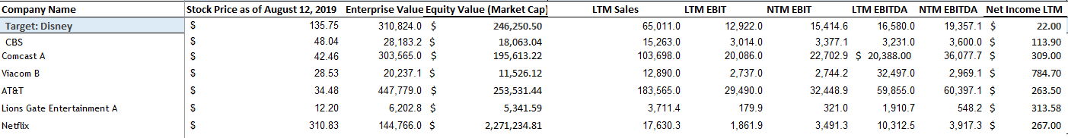
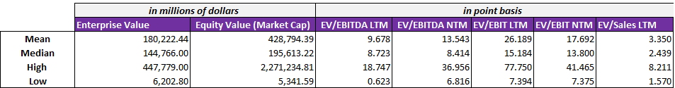
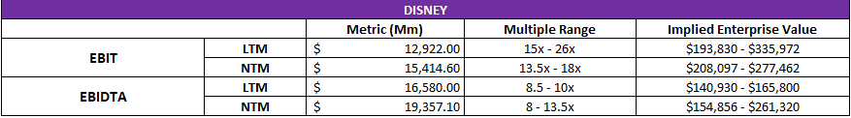
Relative Valuation

